Slide 1
Video games and how they revolutionized the world
Games are a powerful entertaining method that are usually disconsidered and deserve more attention
Do you know what video games are?
DOOM: Old but gold
A new story begins
The Awakening Did we change your mind?
Made by:
Dinu Andrei - Aurelian
Ilie Dumitru
Neculae Andrei - Fabian

Slide 2
Video games 101

Slide 3
What’s it all about?
Old but gold
The awakening
A change of pace

Slide 4
Why about gaming?
It was only naturally to choose something that we felt passionate about to talk in this presentation. As people who dedicate themselves to gaming we would love to present you the wonders of the world of video games.

Slide 5
Why should you care?
We consider that video games are misrepresented among non-gamers when they are actually a form of media that should get more attention for the benefits that it brought not only in the field of entertainment, but also in technology and in computing.

Slide 6

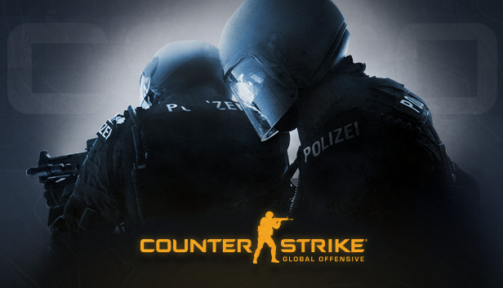
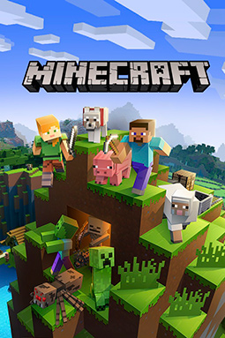

Do you know what video games are?
Video games are a form of media and entertainment where the consumer is active

Slide 7
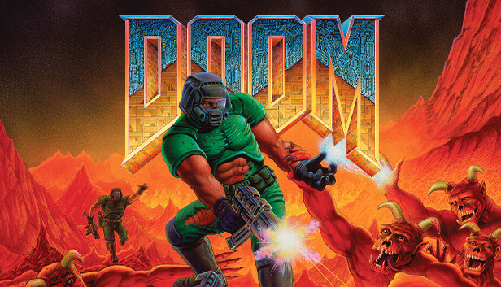
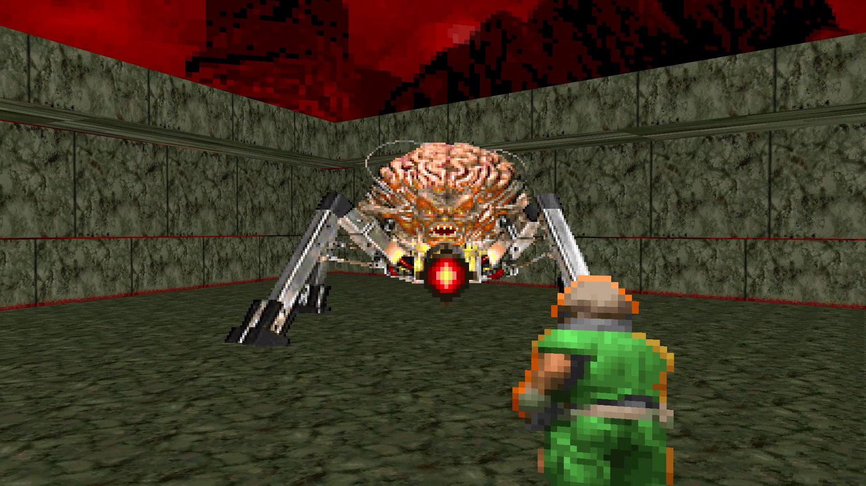
DOOM: Old but Gold
Hell came to earth
You will send it back crying

Slide 8
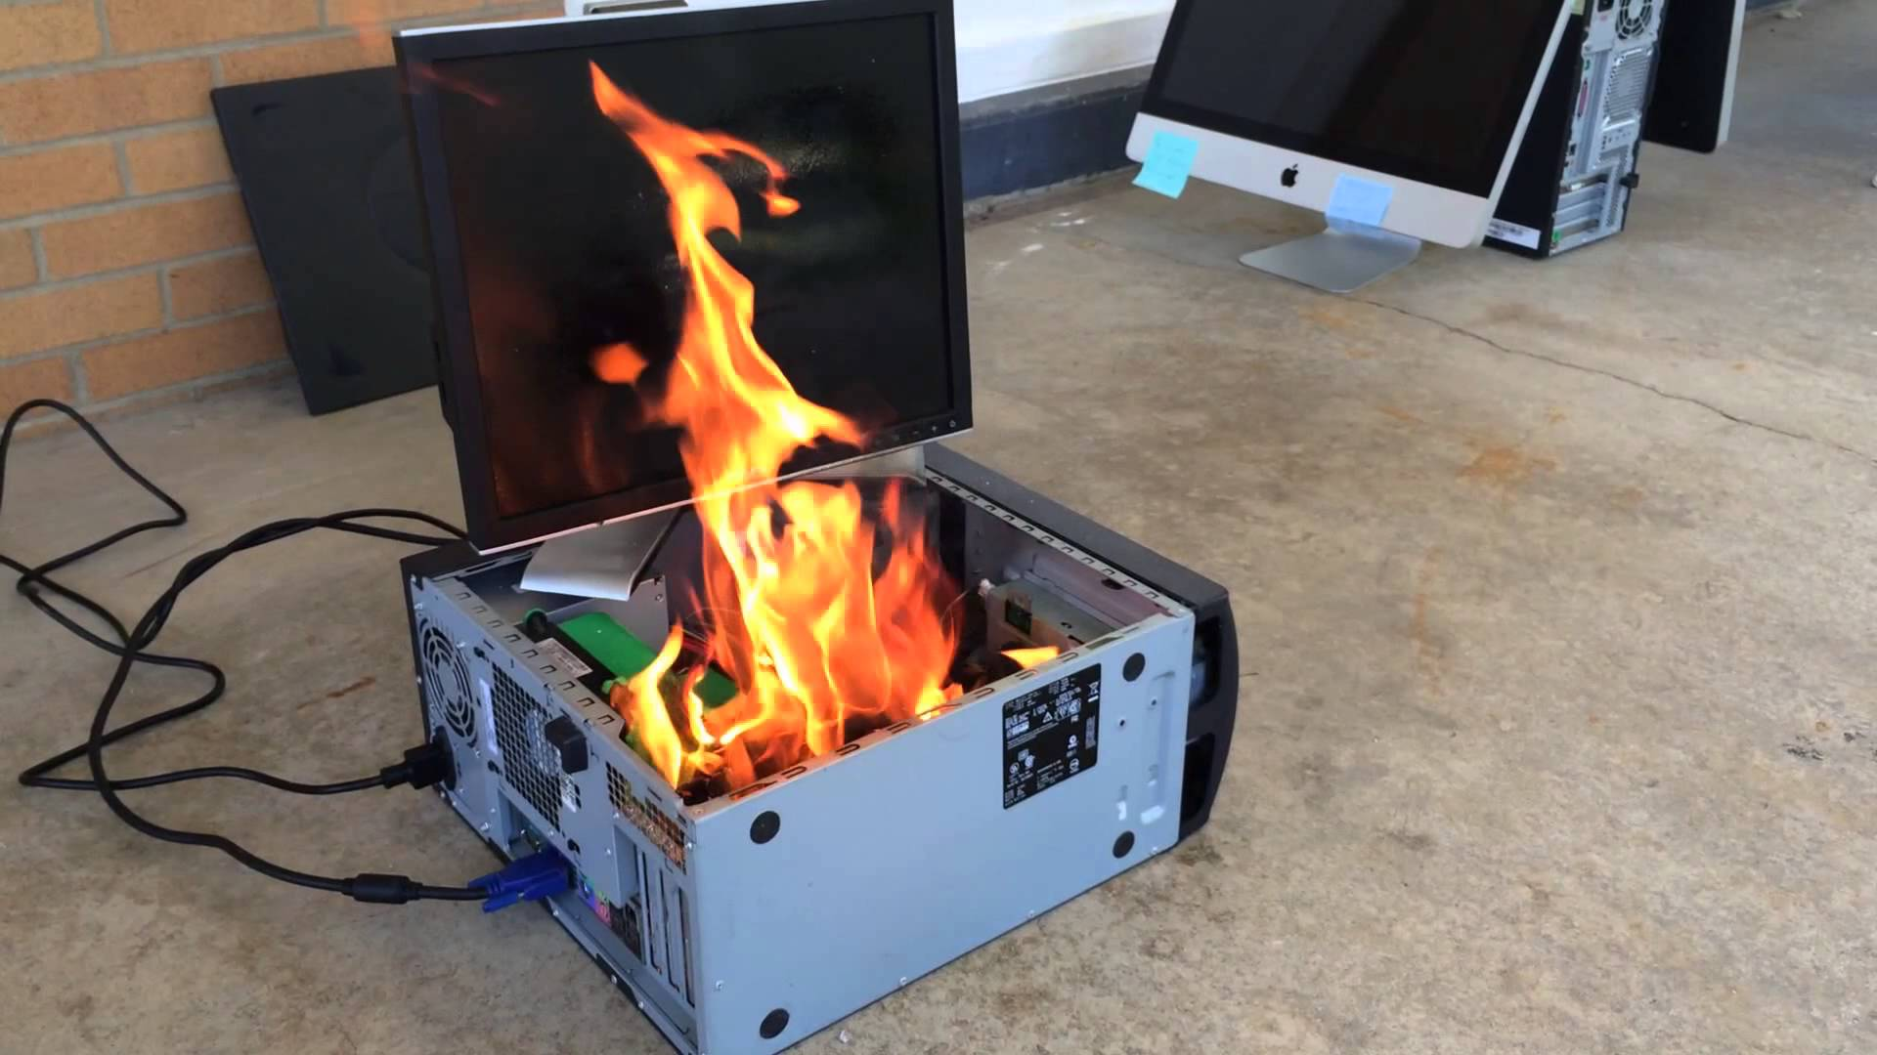
ANYONE UP FOR A BARBEQUE?

Slide 9
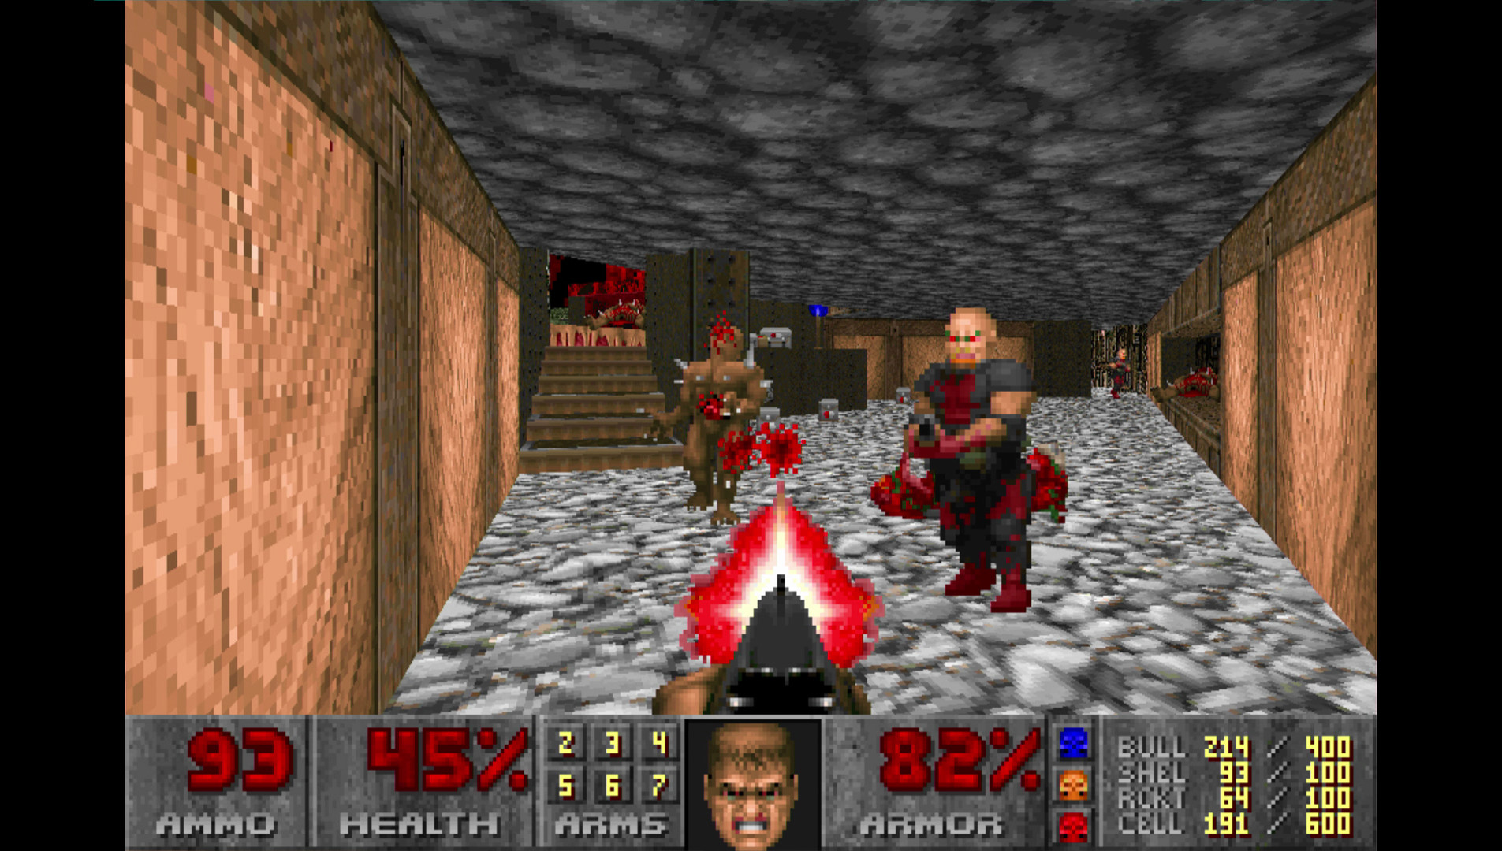
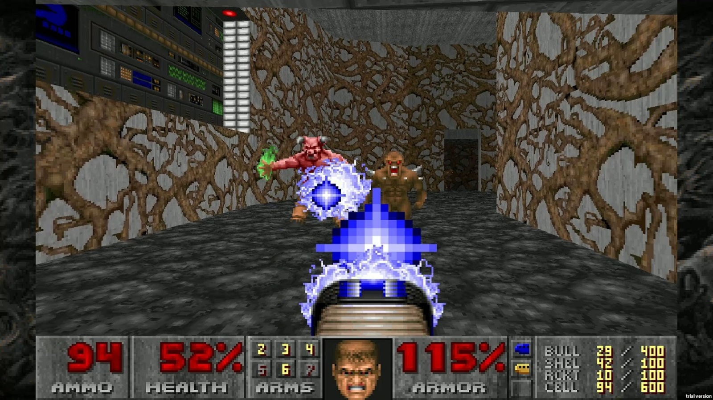
Fast crisp realistic graphics

Slide 10

Do you know this guy?

Slide 11
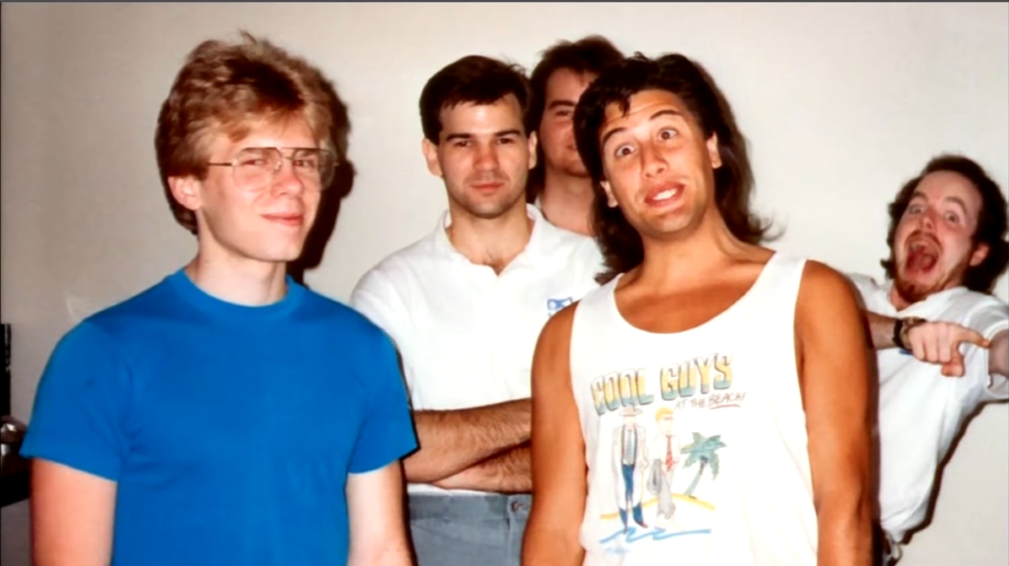
The heavy lifters

Slide 12
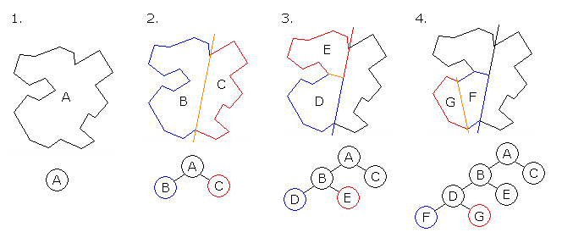
The Magic behind the scenes

Slide 13
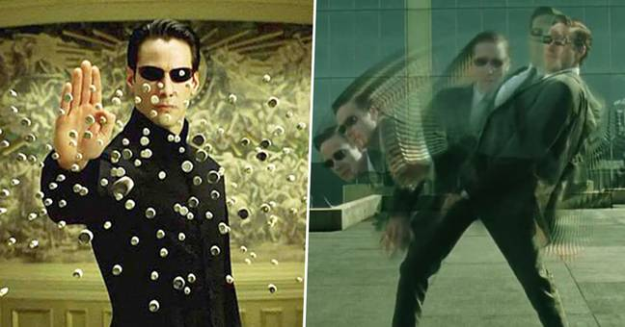
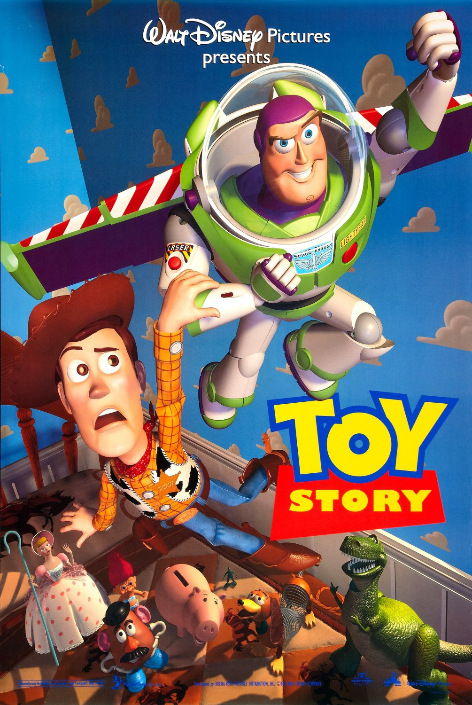

Great movies
with incredible CGI

Slide 14
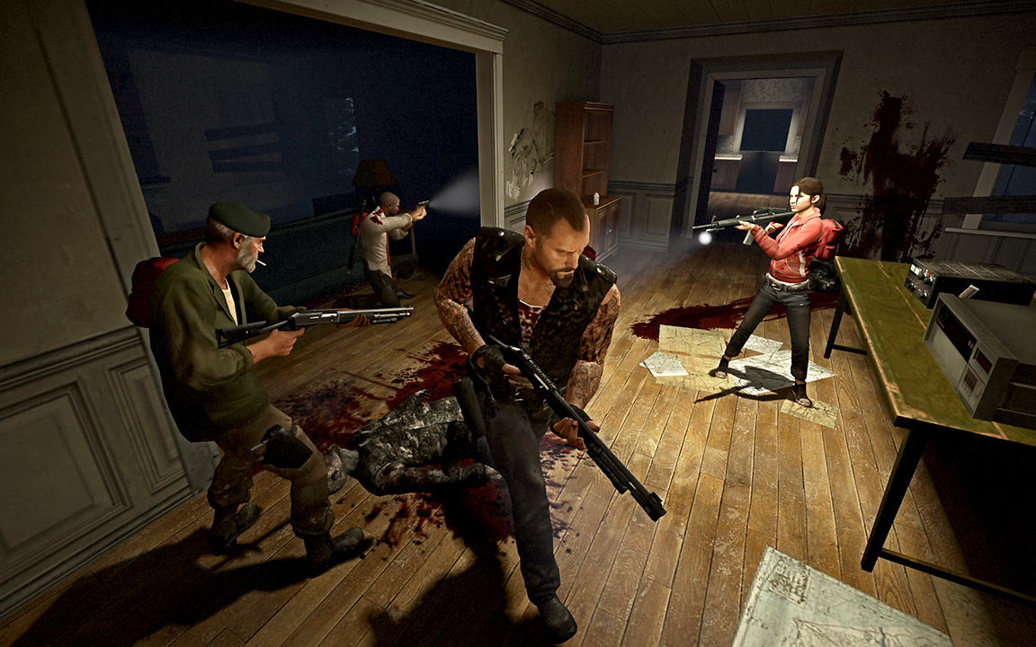
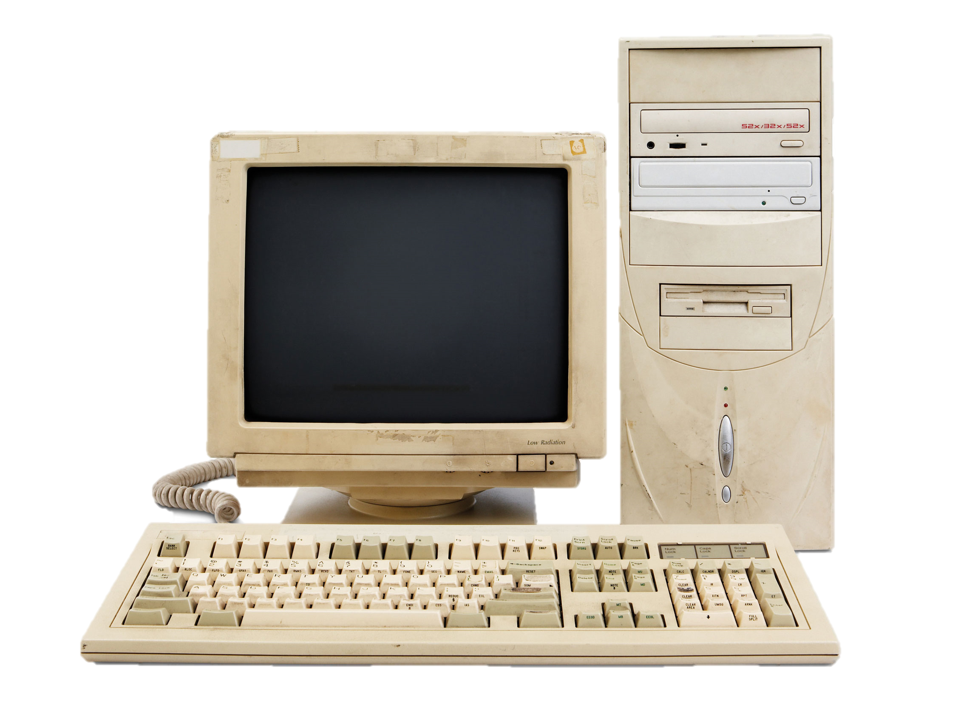
AI in video games
They are good
Send harder zombies!

Slide 15


Amazing AI
concepts

Slide 16
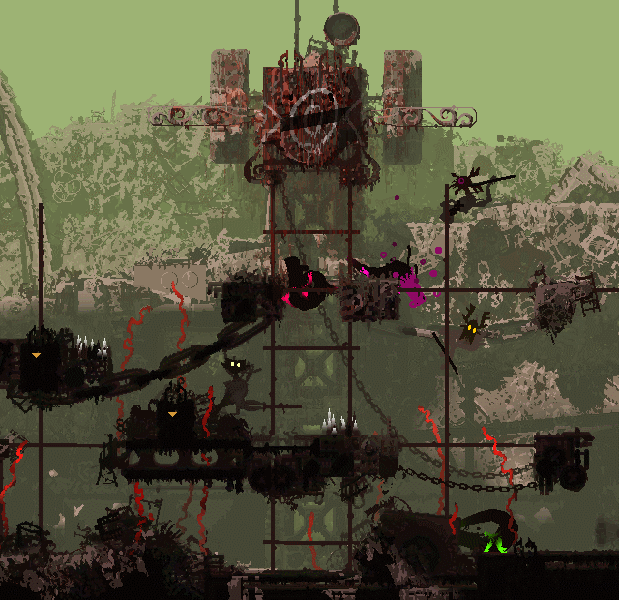
A very complex ecosystem

Slide 17
An evil masterpiece

Slide 18

A change of pace
What happened at the end of an era and the beginning of a new one?

Slide 19
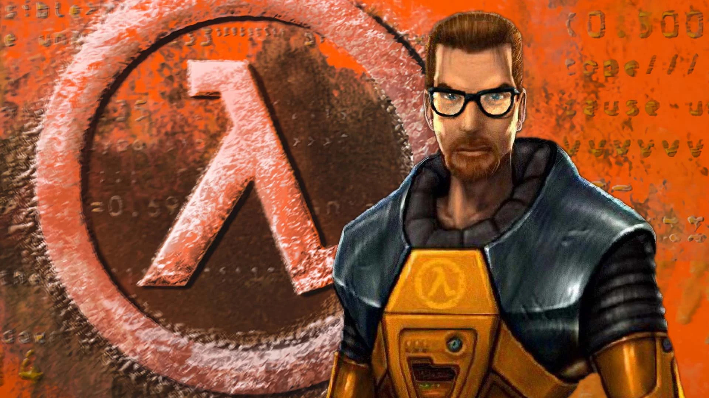
HALF-LIFE
“The closest thing to a revolutionary step the genre has ever taken. Through a series of subtle and artistic design decisions, Half-Life creates a reality that is self-contained, believable, and thoroughly engaging.”
GameSpot

Slide 20
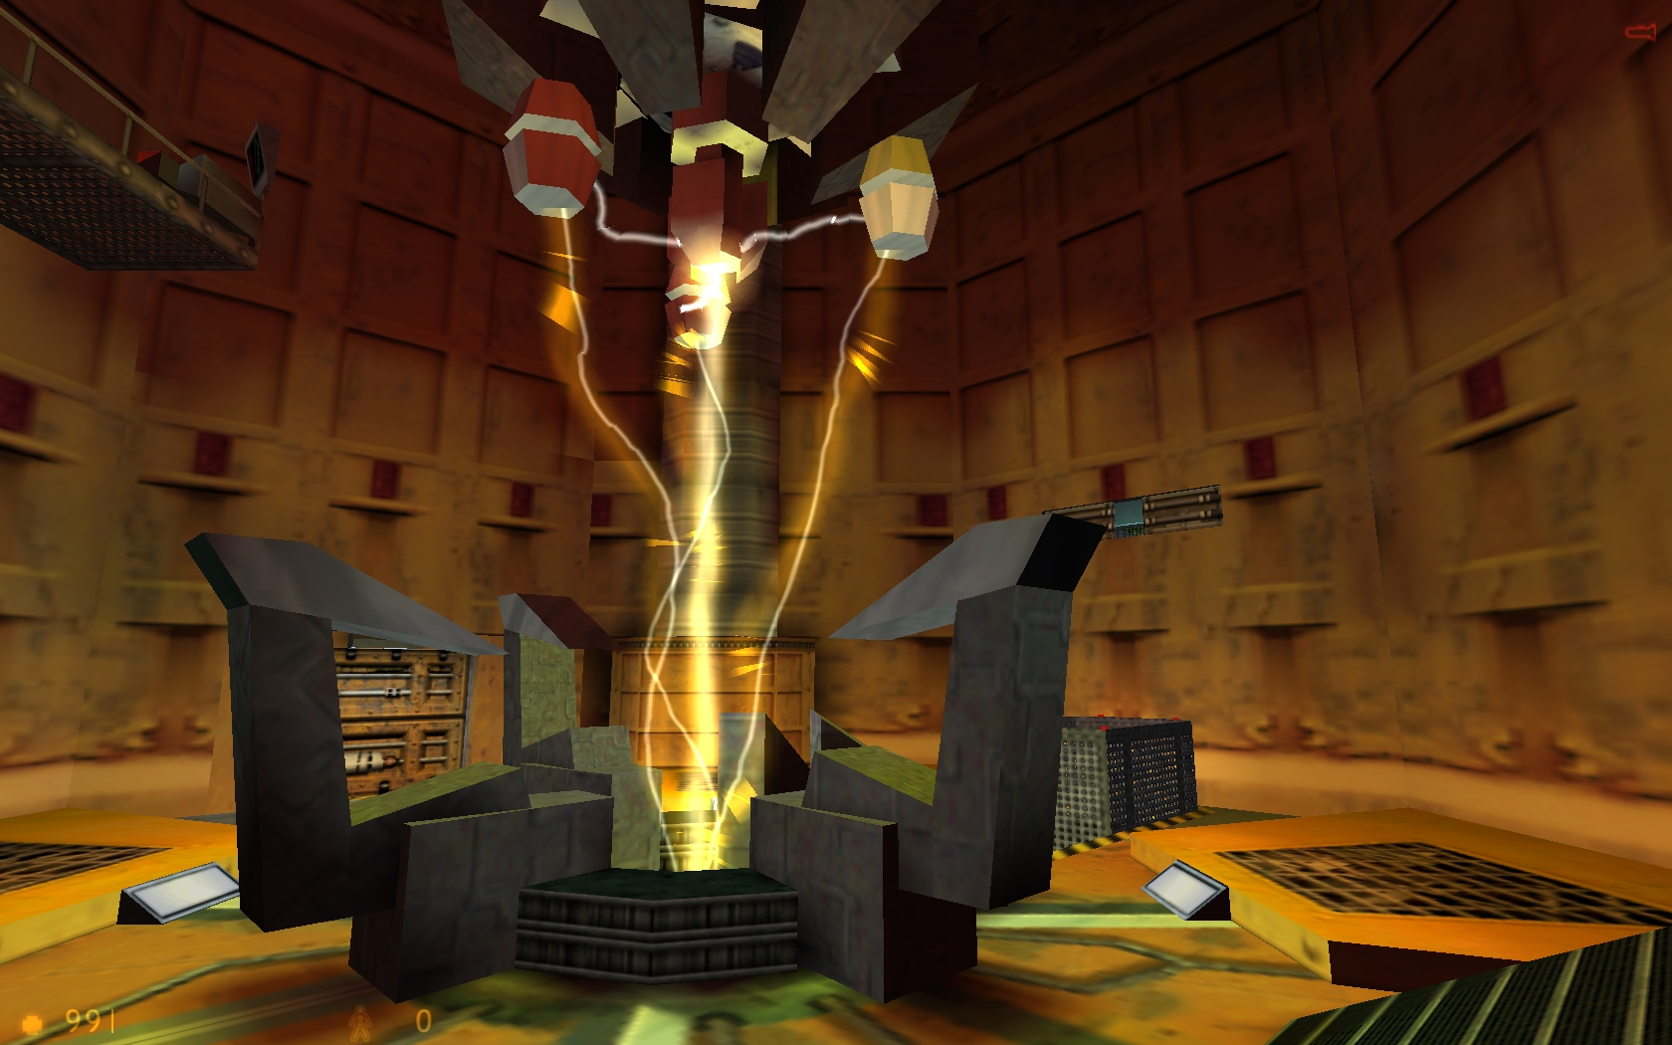
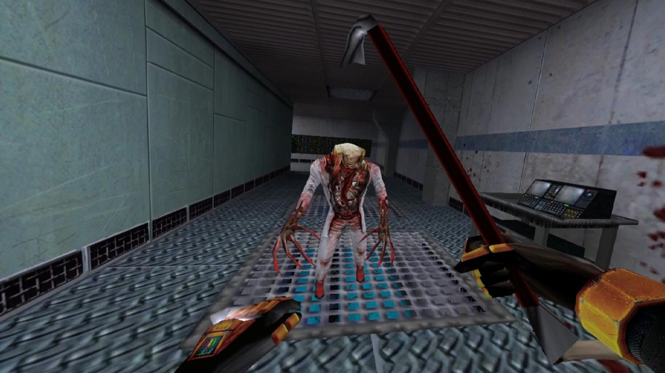
With engaging story
And fun gameplay

Slide 21
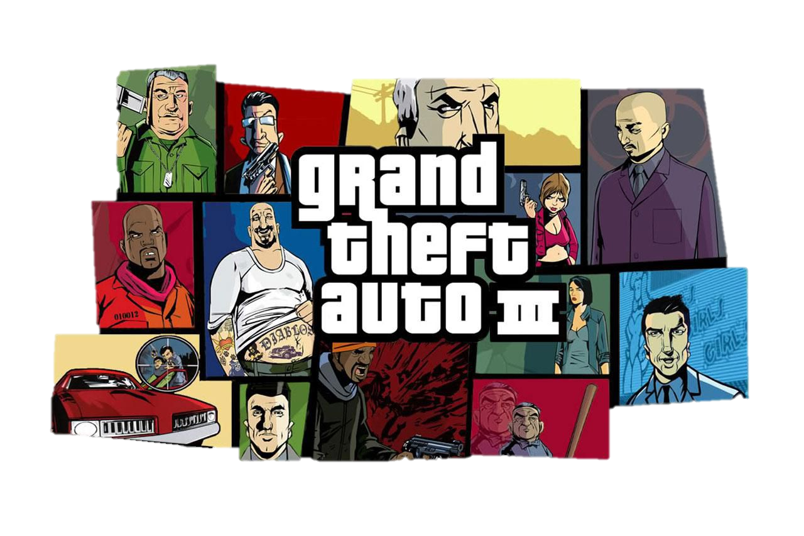
Grand Theft Auto III
One of the most controverted and yet with the most anticipated sequels, Grand Theft Auto, or GTA, is one of the most known series of video games, defining a genre and a name in industry.

Slide 22
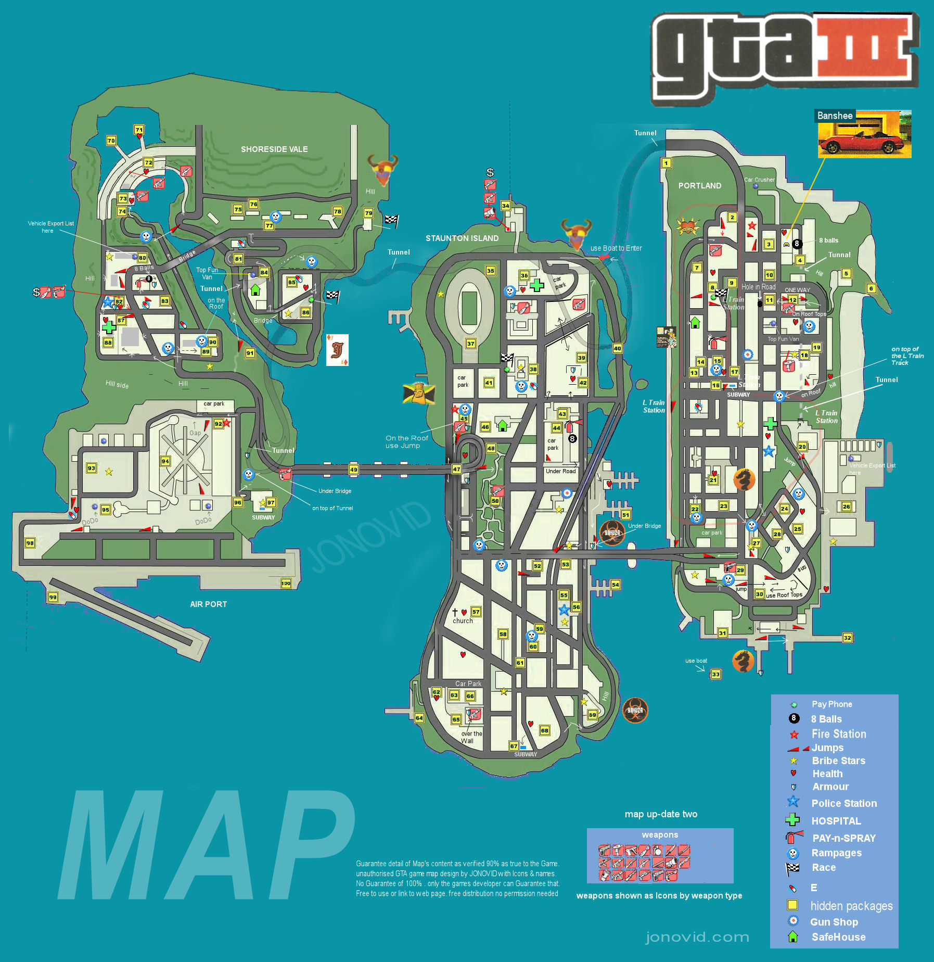
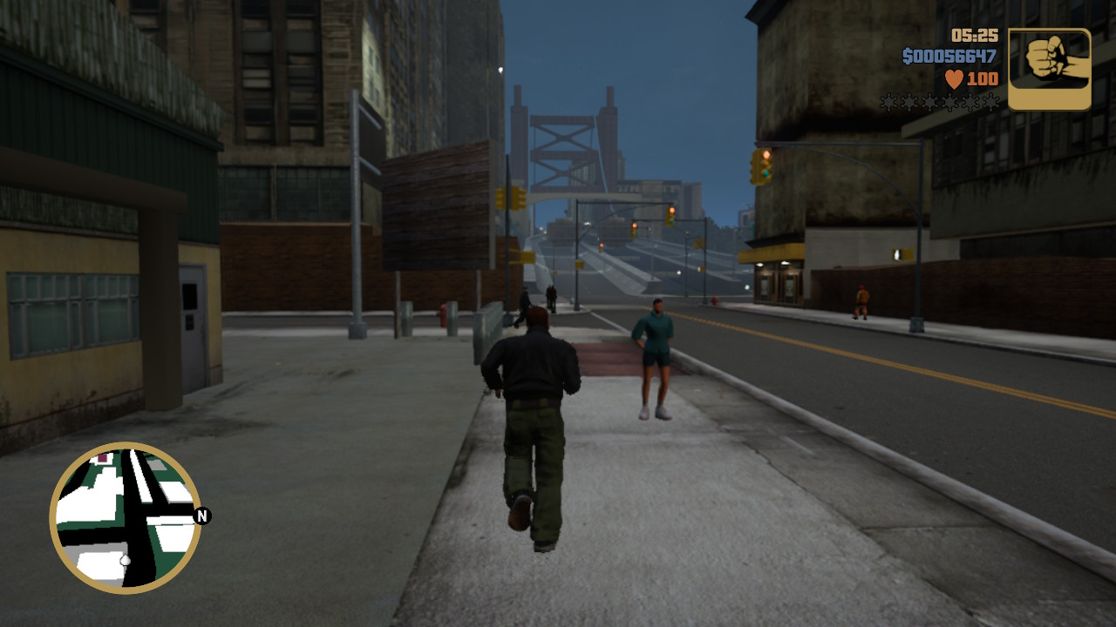
An open world like never before

Slide 23
THANK YOU FOR YOUR ATTENTION

